Slide 1

Credit Card Approval Prediction
By Oussama Errabia
Sr. Data Scientist | MLOps GCP Developer

Slide 2
What To Expect :
Data Presentation
Univariate analysis
Bivariate analysis
Duplicated records
Data Cleaning
Missing Values
Removing Duplication
Data Preparation
Target definition
Features transformation (encoding)
Train/Val/Test split
Handling Imbalanced Data
Data Validation - (Tensorflow Data Validation)
Train schema
Compare train/test/val distributions
ML - logistic regression :
Training
Testing
Metrics - Precision/Recall/F1-Score/AUC
LightGbm :
Training
Testing
Metrics - Precision/Recall/F1-Score/AUC
Model Interpretation (Using SHAP)
Model Calibration
Responsible AI

Slide 3
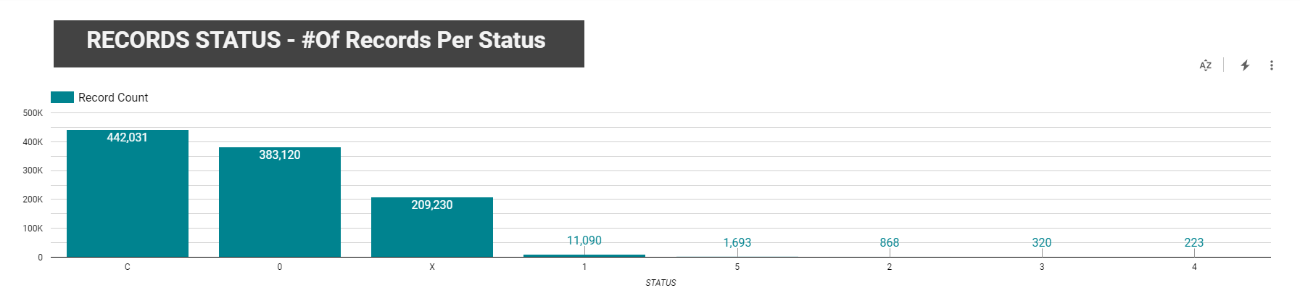
Univariate Analysis
we visualise the dominating status to be the C,0 and the X

Slide 4
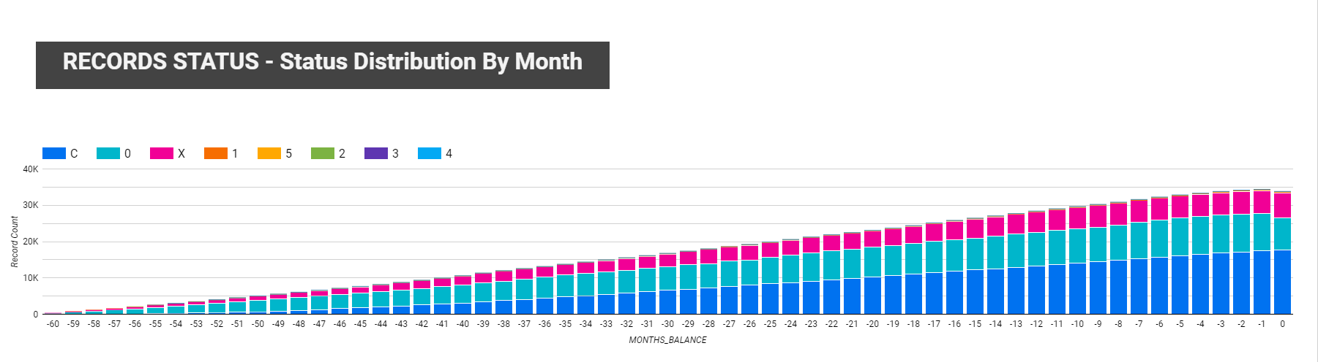
Univariate Analysis
we visualise a steady cumulative Month to Month.
It seems the distribution across status almost remains the same from Month to Month.

Slide 5
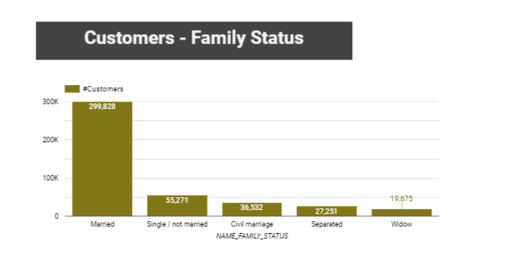
Univariate Analysis
we visualise most customers are Married.

Slide 6
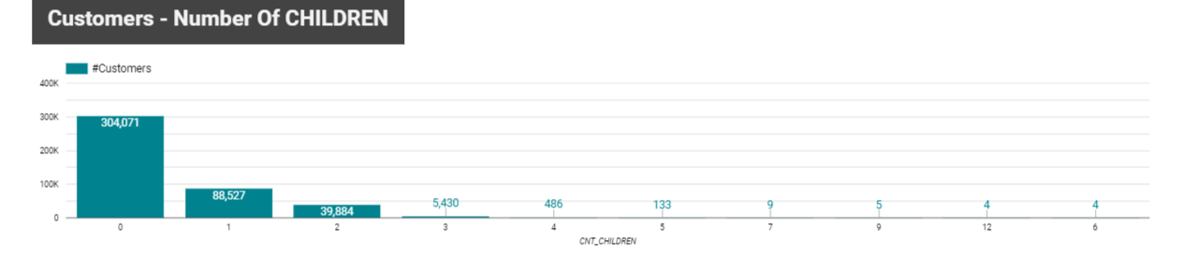
Univariate Analysis
we visualise most Customers have no Children

Slide 7
Univariate Analysis
For more infos on the other features, please check the pdf report.

Slide 8
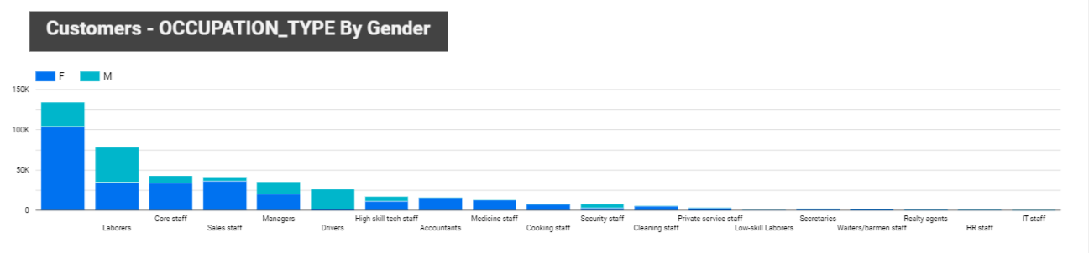
Bivariate Analysis
we visualise that Sales Staff occupation is dominated by womens
We visualise that Labores occupation is dominated by Men

Slide 9
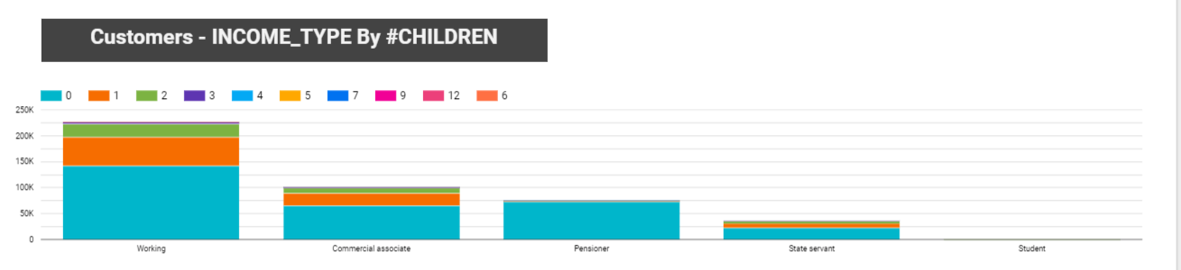
Bivariate Analysis
The interesting thing about this graph is that almost all Pensioner have No Children, which a bit surprising.

Slide 10
Bivariate Analysis
For more infos on the other Interactions, please check the pdf report.

Slide 11
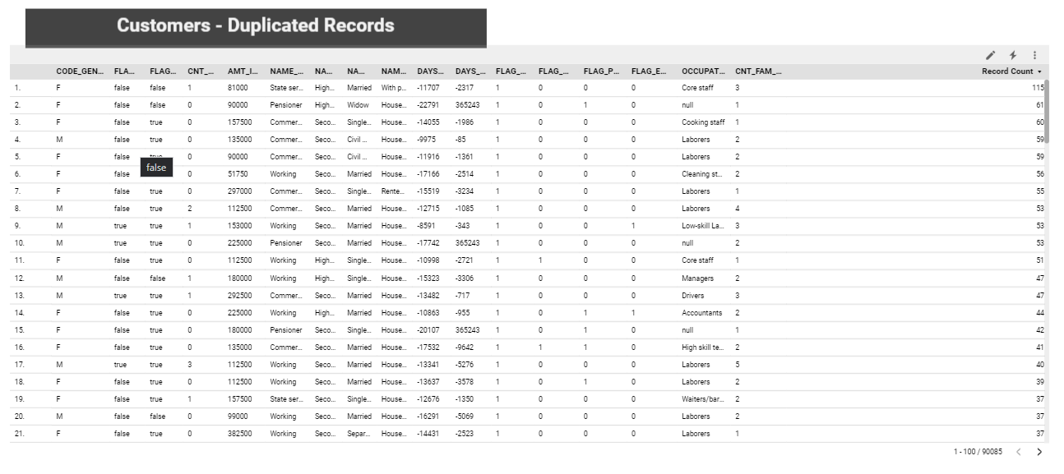
Duplicated Records
By removing the ID from the Application dataset, we can clearly see that there are a lot of duplicated records, like the top one above is duplicated 115 times.
There are only ~90k unique records (from an original ~440k which is 20%)

Slide 12
Data Cleaning :
Missing Values
The only feature that had missing values was the Occupation Type feature (you can notice this from the pdf report)
It was handled by replacing the missing value by NotDefined.

Slide 13
Data Cleaning :
Removing Duplicate
Since all the training features (the X) will be generated from the application data, then it is a must to drop the duplicated values, and so we did.
The credit_record dataset was used to generate the target (the Y) only, so not to introduce any data leakage.

Slide 14
Data Preparation :
Target Definition
Based on the Vintage Analysis provided with the description of the dataset, we defined Bad Customers as customers with past due more than 60 days as it has the most adequate percentage (1.4%).

Slide 15
Data Preparation :
Features Transformations
In ML, features should be numeric and with meaningful magnitude, so :
For Binary features : we coded them into 0 and 1s
For multi-category features : we applied one hot encoding.
We scaled the Continuous features (For Logistic Regression)

Slide 16
Data Preparation :
Train/Val/Test Split
We Split the data into 3 :
Train : it will be used to train the model
Val : it will be used for hyperparameters tuning
Test : it will be used to test and validate the the find model.

Slide 17
Data Preparation :
Handling Imbalanced Data
We managed to handle the extreme imbalance data using models parameters for both the logistic_regression and the lightgbm :
Logistic_regression : class_weight='balanced'
Lightgbm : scale_pos_weight.
Although google recommend downsampling and scale the positive weight in order to keep the models calibrated,however, given the size of the data, i chose to balance the classes using model params and then calibrate the output model

Slide 18
Data Validation :
Tensorflow Data Validation
1 - Motivation
Why Data validation ?
1 - We want to make sure the train/test/val have the same distribution across all features
2 - we want to detect if there is any outliers
3 - we want to generate train schema to be used in production in our pipelines.

Slide 19
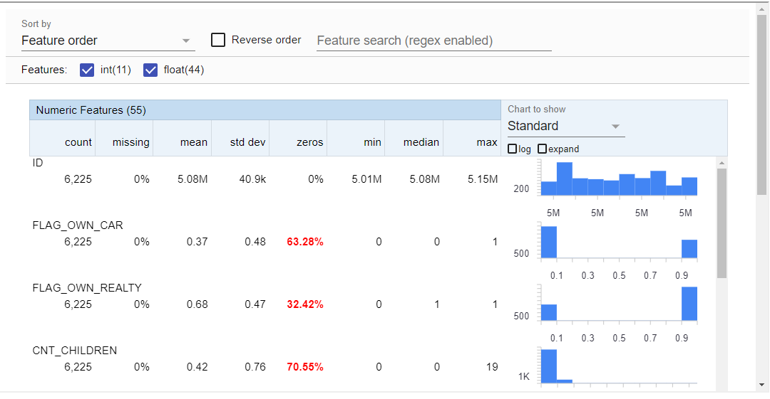
Data Validation :
Tensorflow Data Validation
1 - train stats
For more information, please check the data validation notebook

Slide 20
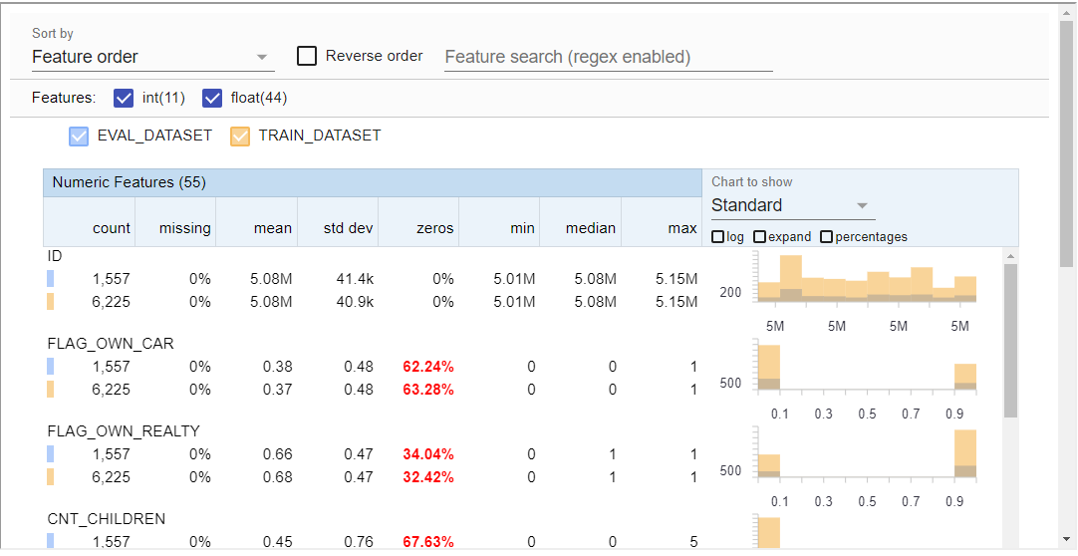
Data Validation :
Tensorflow Data Validation
1 - train/ val distribution
We visualize that the train and val data have identical distribution across all features.
For more information, please visit the notebook

Slide 21
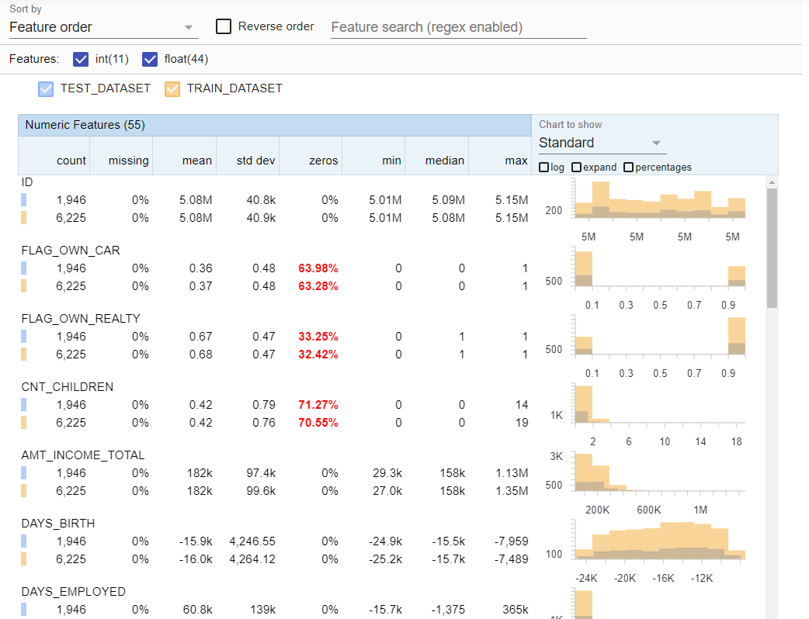
Data Validation :
Tensorflow Data Validation
1 - train/ test distribution
We visualize that the train and test data have identical distribution across all features.
For more information, please visit the notebook

Slide 22
Data Validation :
Tensorflow Data Validation
1 - Outliers Detection
We also used the TFDV to detect outliers, which None are detected
For more information, please visit the notebook

Slide 23
Logistic Regression
Train
We Trained 3 Logistic Regression Models :
1 - trained on all the transformed features generated from the application data.
2 - we used L1 regularization to detect non-useful features (which will have a coef of 0 ) and then we dropped those features to train the second model
3 - we used Correlation analysis to detect collinearity, as it hurts logistic regression model, so we removed highly correlated feature and we used the remaining ones to train the third model.
We also noticed a slight increase in the metrics we observe as we move from a model to the other.

Slide 24
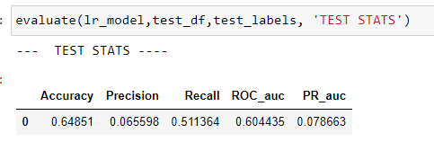
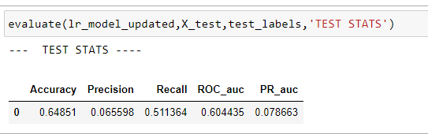
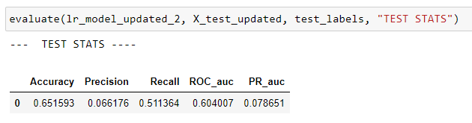
Logistic Regression
Testing & Metrics
The above 3 tables shows the metrics of the 3 models from 1 to 3 respectively.
All 3 models have a recall in the range of 0.5x and a precision of 0.0x, which definitely a clear indicator that the models are not doing great which can be explained by many reasons the obvious on is the data is too noisy.

Slide 25
LightGbm
Train
We trained light gbm model on the same data used to train the logistic regression model
The model also suffered from the noise in the data which can be noticed from how easy the model can overfit with almost perfect train score with very bad test scores.

Slide 26
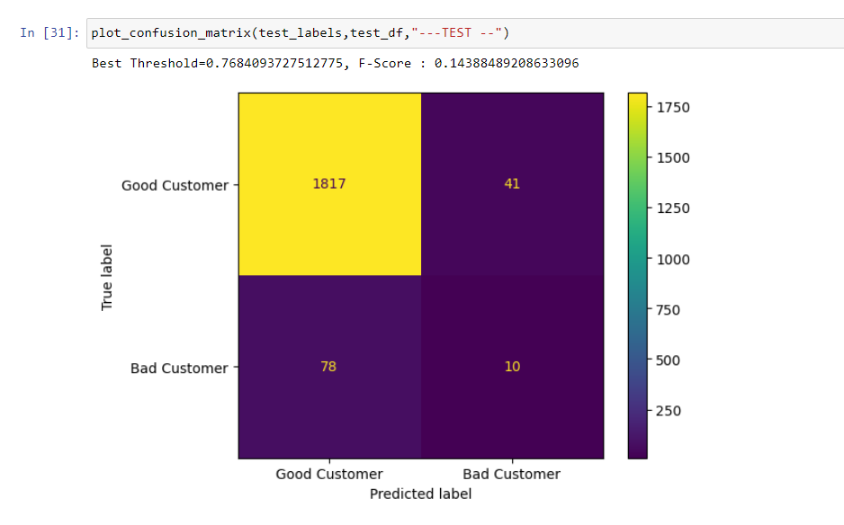
LightGbm
Testing & Metrics
1 - Confusion Matrix
As we mentioned earlier, the model is doing no so great on the test data, even low in performance compared to logistic regression, this due to the high amount of noise in the data that the model easily learns from.
All of this is confirmed by the above confusion matrix.

Slide 27
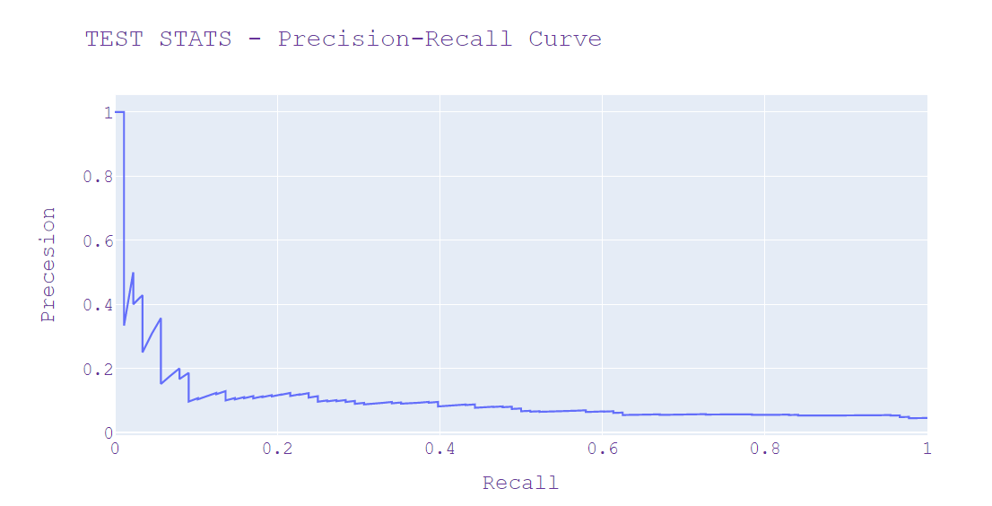
LightGbm
Testing & Metrics
1 - Precision-Recall Curve
We usually use the precision-recall cruve to find the best tradeoff between the precision and recall.
We observe from the above curve that the model is not doing so great on the test data.

Slide 28
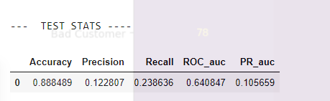
LightGbm
Testing & Metrics
1 - Precision / Recall / AUC
We observe an auc of 0.64, which mean the model is ok in ranking from good customers to bad customers, however, in our case, we care more about recall and precision
The model is performing not so great on both the recall and precision

Slide 29
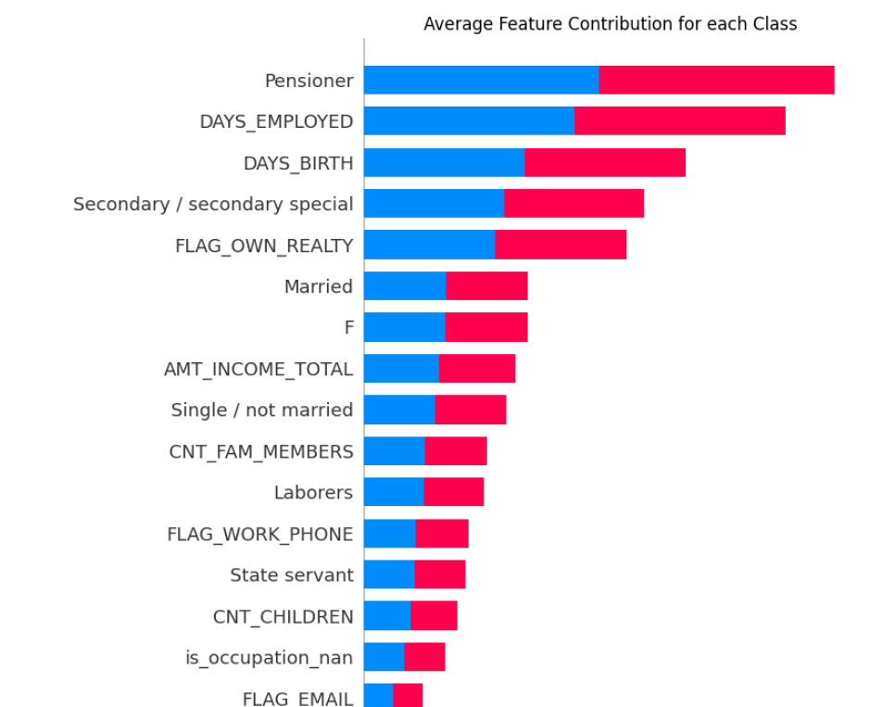
LightGbm
Model Interpretation
1 - Feature Importance using SHAP
We used the shap package to observe the features importance given our lightgbm model.
The above graph shows the top important features.

Slide 30
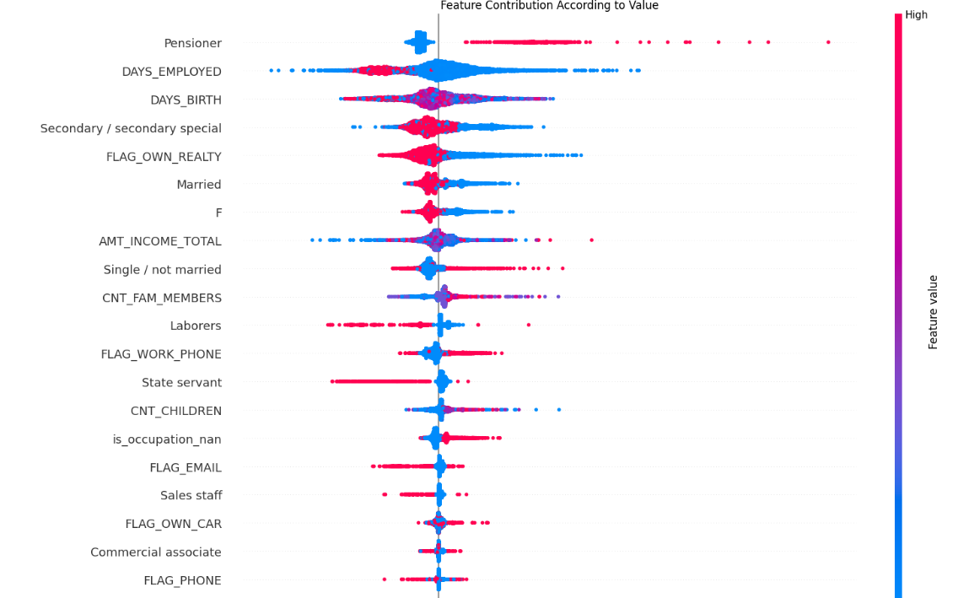
LightGbm
Model Interpretation
2 - Feature Contribution By Value
There is a lot to say for analyzing the above graph, and just to mention a few :
Low values for Days Employed seems to push the customers to the bad side, which is expected, however, what is not expected is to see some low values push the customer to the good side

Slide 31
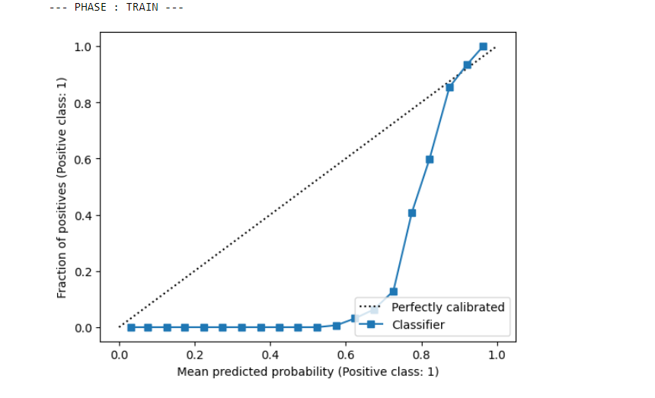
LightGbm
Model Calibration
We usually care about Calibration in order to interpret the output of our model as probabilities.
The above graph is the calibration curve of our lightgbm model, it needs extra post processing for calibration, like Istonic Calibration.

Slide 32
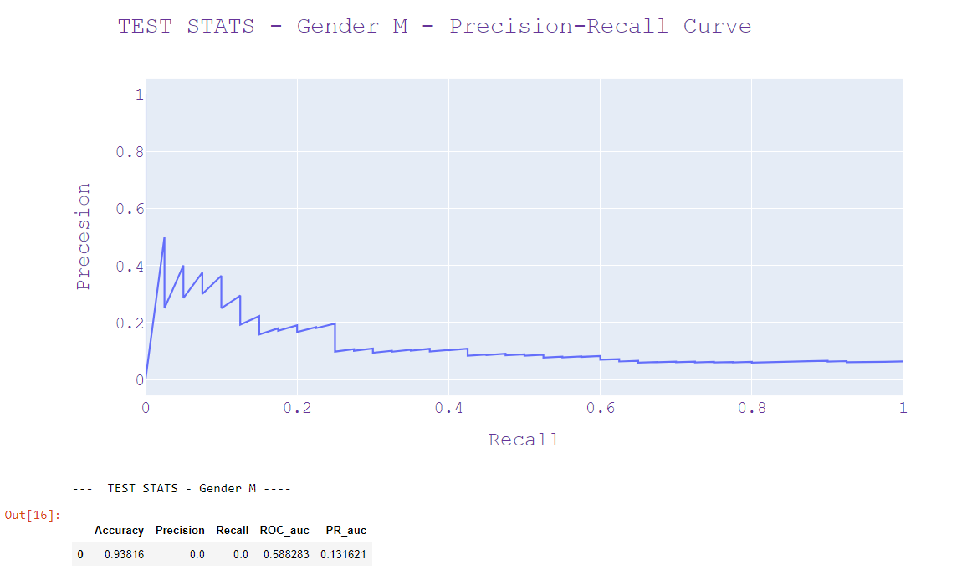
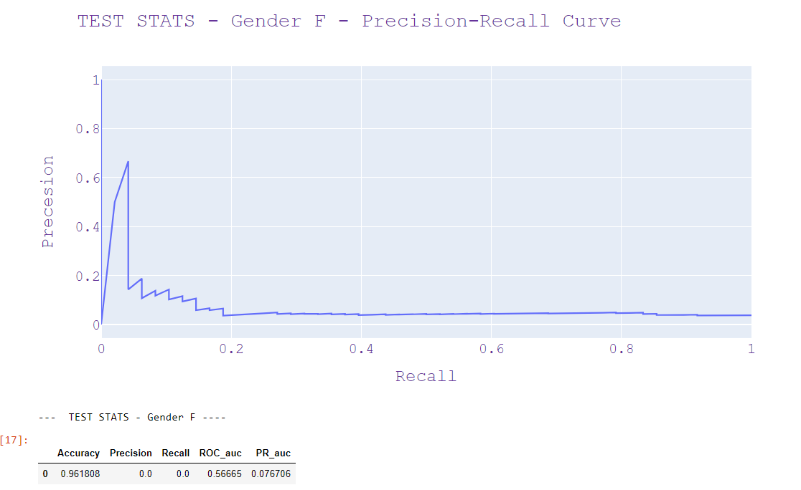
LightGbm
Responsible AI
Given we are using Gender as a feature, it is important to check for bias by computing the models performance by Gender.

Slide 33
Final Notes
The PDF report was generated using Looker Studio, the data was imported into BigQuery first.
The trained models seems to report an OK AUC even though they are optimized for F1-score (recall and precision), given that, it can be useful to have a good ranking of customers.
I did not redo the Vintage Analysis given the fact it is already done and reported in the description of the dataset

Slide 34
Thank You

